Slide 1

Internship Project
on
Website and Application Development for Vegetable Market Logs
Project Manager and Mentor:
Mr. Yuvraj Joshi
Assistant Professor,
Department of Computer Science & Engineering
Graphic Era Deemed to be University, Dehradun,
Uttarakhand, India (248002)

Slide 2
Content Day 3
Browser
VScode
Xampp
Hypertext Markup Language (HTML)
Cascading Style Sheets (CSS)

Slide 3
Browser
- A browser is a software application for accessing and interacting with the internet.
- It provides a graphical user interface (GUI) to navigate and display web pages.
- Examples include Google Chrome, Mozilla Firefox, Safari, and Microsoft Edge.
- Browsers use rendering engines to interpret and display web content, such as HTML, CSS, and JavaScript.
- They support features like tabbed browsing, bookmarks, and search functionality.
- Security features protect against malicious websites and maintain user privacy.
- Extensions and add-ons enhance browser functionality (e.g., ad blockers, password managers).
- Browsers are available on multiple platforms, including Windows, macOS, Linux, Android, and iOS.

Slide 4
VScode
VScode, short for Visual Studio Code, is a popular source code editor developed by Microsoft. It is lightweight, highly customizable, and supports a wide range of programming languages and frameworks. Here's a brief introduction to VScode and how to install it:
Introduction:
- VScode is a free and open-source source code editor.
- It provides a modern and feature-rich environment for coding, debugging, and version control integration.
- It offers a wide range of extensions that enhance its functionality, allowing users to customize their development experience.

Slide 5
VScode
Installation:
1. Visit the official VScode website at https://code.visualstudio.com.
2. Choose the appropriate version for your operating system (Windows, macOS, or Linux) and click on the download link.
3. Once the download is complete, run the installer file.
4. Follow the on-screen instructions to complete the installation process.
5. After installation, launch VScode, and you're ready to start coding.

Slide 6
VScode
Languages Supported:
- JavaScript
- Python
- C++
- Java
- HTML/CSS
- PHP
- Ruby
- Go
- TypeScript
- Rust

Slide 7
VScode
Benefits:
- Integrated Development Environment (IDE) with a lightweight and customizable interface.
- Supports a wide range of programming languages and frameworks.
- Offers a rich set of features, including code editing, debugging, version control, and terminal access.
- Provides powerful code navigation and search capabilities.
- Offers a vast collection of extensions to enhance functionality and support specific workflows.
- Enables collaboration through Live Share, allowing real-time code editing and sharing.
- Cross-platform compatibility, available for Windows, macOS, and Linux.
- Regular updates and a large and active community contribute to ongoing improvements and support.

Slide 8
Xampp
XAMPP is an open-source software package that provides a local development environment for building web applications. It stands for cross-platform (X), Apache (A), MariaDB/MySQL (M), PHP (P), and Perl (P). Here's a brief introduction and installation guide for XAMPP:
Introduction:
XAMPP combines all the necessary components required to run a web server on your local machine, making it easier to develop and test web applications offline. It includes the Apache web server, MySQL or MariaDB database, PHP scripting language, and Perl programming language.

Slide 9
Xampp
Installation:
1. Download XAMPP: Visit the official Apache Friends website (https://www.apachefriends.org) and download the appropriate version of XAMPP for your operating system (Windows, macOS, or Linux).
2. Run the Installer: Locate the downloaded installer file and run it. Follow the installation wizard's instructions to proceed.
3. Select Components: During the installation process, you can choose which components to install. By default, Apache, MySQL/MariaDB, PHP, and phpMyAdmin (a tool for managing databases) are selected. You can keep the default selection or customize it based on your needs.
4. Choose Installation Folder: Select the folder where you want to install XAMPP. The default installation path is usually fine, but you can choose a different location if desired.

Slide 10
Xampp
Installation (contd.):
5. Start the Installation: Click the "Install" button to start the installation process. The installer will copy the necessary files to your selected folder.
6. Complete the Installation: Once the installation is finished, you will see a confirmation message. You may be prompted to install additional components, such as Visual C++ Redistributable, if needed.
7. Launch XAMPP: After installation, you can launch XAMPP from the installation folder. On Windows, you can start XAMPP by running the "xampp-control.exe" file.
8. Start Services: In the XAMPP control panel, you will see various services like Apache, MySQL/MariaDB, and others. Start the services you need for your development environment by clicking the "Start" button next to each service.
9. Test the Installation: Open your web browser and enter "http://localhost" in the address bar. If XAMPP is installed correctly, you should see the XAMPP welcome page.

Slide 11
HTML
HTML (Hypertext Markup Language) is the standard markup language used for creating web pages. It provides a structure and format for organizing content on the internet. Here's a brief introduction to HTML, commonly used elements, and a list of tags and attributes:
Introduction:
HTML uses tags to define elements that structure and present content on a web page. It consists of opening and closing tags, with content placed between them. Tags are enclosed in angle brackets (< and >).

Slide 12
HTML
Commonly Used HTML Elements:
1. `<html>`: The root element of an HTML page.
2. `<head>`: Contains meta-information about the HTML document.
3. `<title>`: Specifies the title of the web page displayed in the browser's title bar.
4. `<body>`: Contains the visible content of the web page.
5. `<h1> to <h6>`: Heading elements of different levels.
6. `<p>`: Defines a paragraph.
7. `<a>`: Creates a hyperlink to another web page or resource.
8. `<img>`: Inserts an image into the web page.
9. `<ul>` and `<li>`: Create unordered lists and list items, respectively.
10. `<ol>` and `<li>`: Create ordered lists and list items, respectively.
11. `<div>`: Defines a division or section in the web page.
12. `<span>`: Used for inline styling and grouping of elements.
13. `<table>`: Creates a table for tabular data.

Slide 13
HTML (Code Structure)
<!DOCTYPE html>
<html>
<head>
<title>My Web Page</title>
<link rel="stylesheet" href="styles.css">
</head>
<body>
<h1>Welcome to My Web Page</h1>
<p>This is a paragraph of text.</p>
<img src="image.jpg" alt="My Image">
<a href="https://www.example.com">Visit Example.com</a>
</body>
</html>

Slide 14
HTML
HTML Tags and Attributes:
1. `<a>` (anchor):
- `href`: Specifies the URL or destination of the link.
Example: `<a href="https://www.example.com">Link</a>`

Slide 15
HTML
HTML Tags and Attributes:
2. `<img>` (image):
- `src`: Specifies the image URL.
- `alt`: Provides alternative text for the image.
Example: `<img src="image.jpg" alt="Image description">`

Slide 16
HTML
HTML Tags and Attributes:
3. `<table>` (table):
- `border`: Sets the border width of the table.
Example: `<table border="1">...</table>`

Slide 17

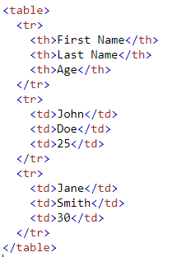

Slide 18
HTML
HTML Tags and Attributes:
4. `<input>` (input):
- `type`: Specifies the input type (e.g., text, checkbox, radio, etc.).
Example: `<input type="text" name="username">`

Slide 19
HTML
HTML Tags and Attributes:
5. `<form>` (form):
- `action`: Specifies the URL where form data is sent.
- `method`: Defines the HTTP method for submitting the form (e.g., GET or POST).
Example: `<form action="submit.php" method="post">...</form>`

Slide 20
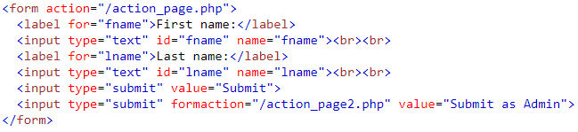
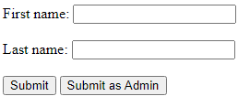

Slide 21
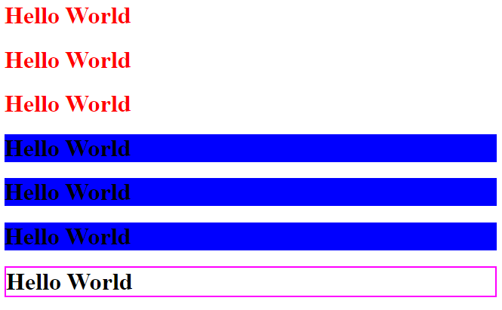
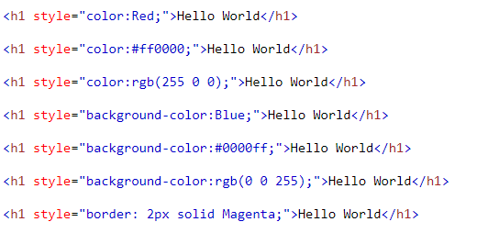
HTML
Colors

Slide 22
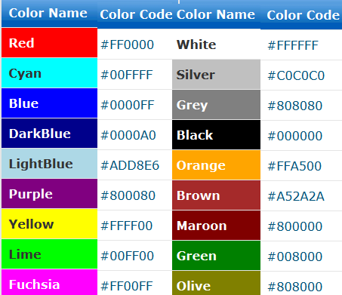

Slide 23
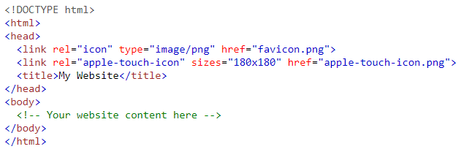
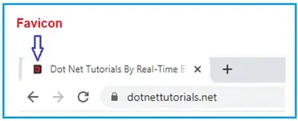
HTML
Favicon

Slide 24
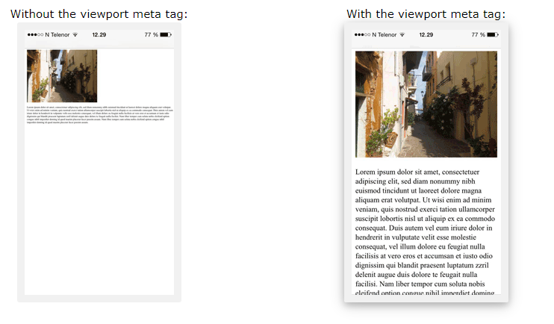
HTML
Responsive

Slide 25
CSS
CSS (Cascading Style Sheets) is a styling language used to describe the presentation and layout of HTML documents.
It allows you to control the appearance of web pages, making them visually appealing and engaging.
Example of CSS used:
body { background-color: lightblue; } h1 { color: white; text-align: center; } p { font-family: verdana; font-size: 20px; }

Slide 26
CSS
Types of CSS
1. Inline CSS:
- Apply styles directly to individual HTML elements using the `style` attribute.
- Example:
<p style="color: blue; font-size: 18px;">This is a paragraph with inline CSS.</p>

Slide 27
CSS
Types of CSS
2. Internal CSS:
- Define styles within the `<style>` tags in the `<head>` section of an HTML document.
<head>
<style>
p {
color: blue;
font-size: 18px;
}
</style>
</head>
<body>
<p>This is a paragraph with internal CSS.</p>
</body>

Slide 28
CSS
Types of CSS
3. External CSS
- Create a separate CSS file with a .css extension and link it to an HTML document using the `<link>` tag.
- Example:
<head>
<link rel="stylesheet" href="styles.css">
</head>
<body>
<p>This is a paragraph with external CSS.</p>
</body>
Assuming the CSS file is named "styles.css" and located in the same directory as your HTML file.

Slide 29
CSS
Selectors:
1. Simple Selectors:
- Element Selector: Targets elements by their tag name.
Example: `p { color: blue; }` targets all `<p>` elements.
- Class Selector: Targets elements with a specific class attribute.
Example: `.highlight { background-color: yellow; }` targets elements with `class="highlight"`.
- ID Selector: Targets elements with a specific id attribute.
Example: `#logo { width: 200px; }` targets an element with `id="logo"`.

Slide 30
CSS
Selectors:
2. Nested Selectors:
- Descendant Selector: Targets elements that are descendants of a specific parent element.
Example: `div p { color: blue; }` targets `<p>` elements inside a `<div>`.
- Child Selector: Targets elements that are direct children of a specific parent element.
Example: `ul > li { font-weight: bold; }` targets `<li>` elements that are direct children of `<ul>`.

Slide 31
CSS
Selectors:
3. Combinator Selectors:
- Adjacent Sibling Selector: Targets an element that immediately follows another element.
Example: `h2 + p { color: red; }` targets a `<p>` element that directly follows an `<h2>`.
- General Sibling Selector: Targets elements that follow a specific element.
Example: `h2 ~ p { color: red; }` targets `<p>` elements that follow an `<h2>`.

Slide 32
CSS
Selectors:
4. Pseudo-Class Selectors:
- Targets elements based on a specific state or interaction.
- Example: `a:hover { color: red; }` targets `<a>` elements when hovered over by the mouse.

Slide 33
CSS
Selectors:
5. Pseudo-Element Selectors:
- Targets specific parts of an element's content.
- Example: `p::first-line { font-weight: bold; }` targets the first line of `<p>` elements.

Slide 34
CSS
Selectors:
6. Attribute Selectors:
- Targets elements based on their attributes and attribute values.
- Example: `input[type="text"] { border: 1px solid black; }` targets `<input>` elements with `type="text"`.

Slide 35
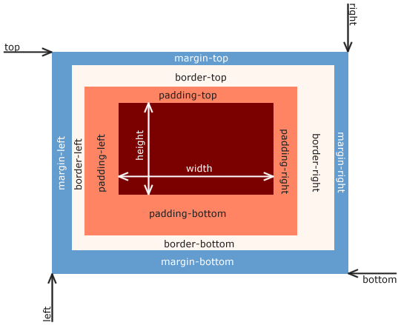
CSS
BOX MODEL:
- The box model describes how elements are rendered on the web page, including their content, padding, borders, and margins.

Slide 36
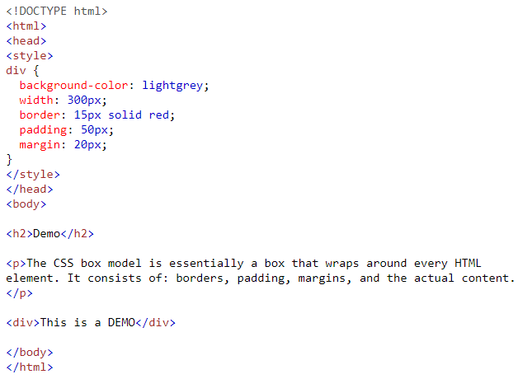
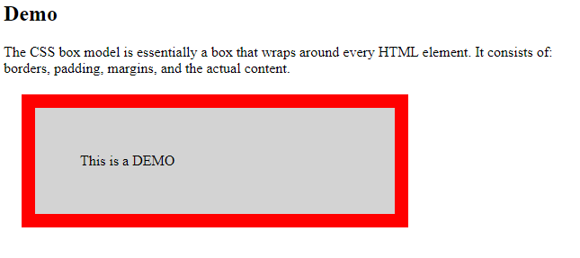

Slide 37
CSS
Typography:
- CSS allows you to style text, including properties like font size, font family, color, and text alignment.
- Example:
h1 {
font-size: 24px;
font-family: Arial, sans-serif;
color: #333;
text-align: center;
}

Slide 38
CSS
Layout:
- CSS provides techniques for controlling the layout of web pages, such as using flexbox or CSS grid.
- Example:
.container {
display: flex;
justify-content: center;
align-items: center;
}

Slide 39
CSS
Media Queries:
- Media queries allow you to apply different styles based on different screen sizes or devices.
- Example:
@media (max-width: 768px) {
/* Styles for screens with a maximum width of 768px */
.container {
flex-direction: column;
}
}

Slide 40
First Objective: To create a structure of a home page with HTML & CSS

Slide 41
< thanks / >

